Slide 1
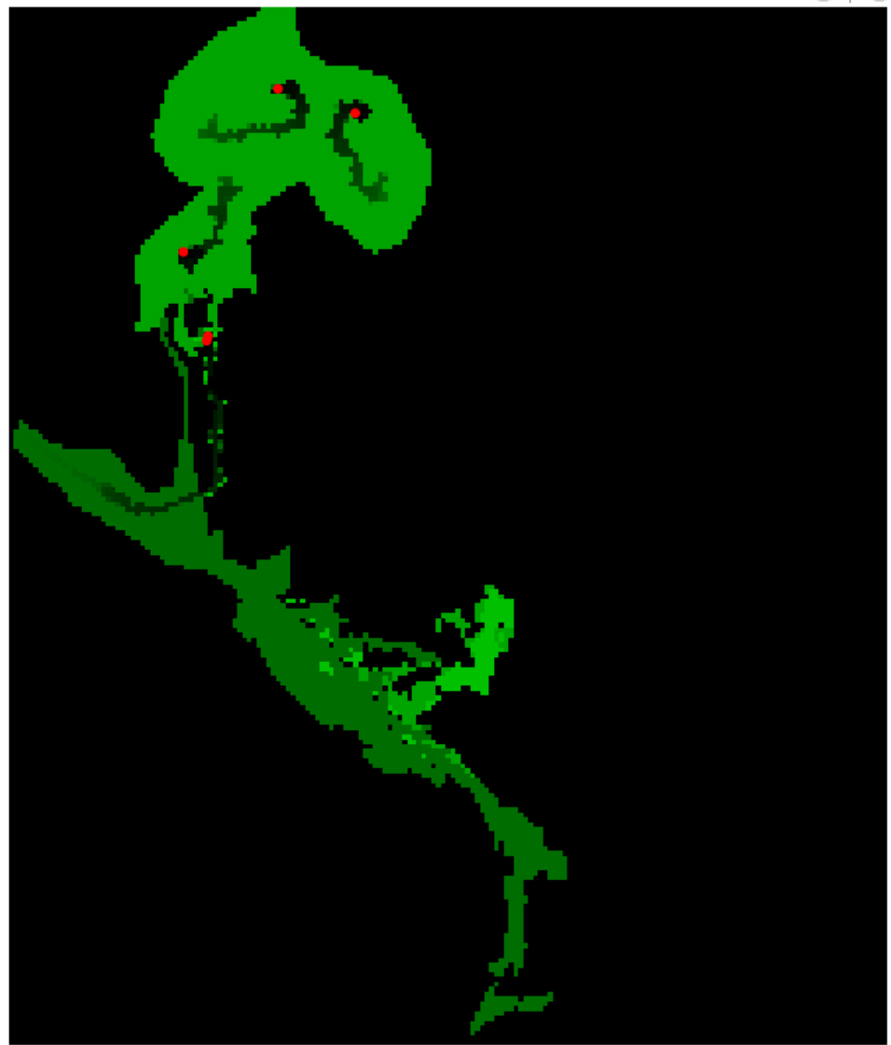
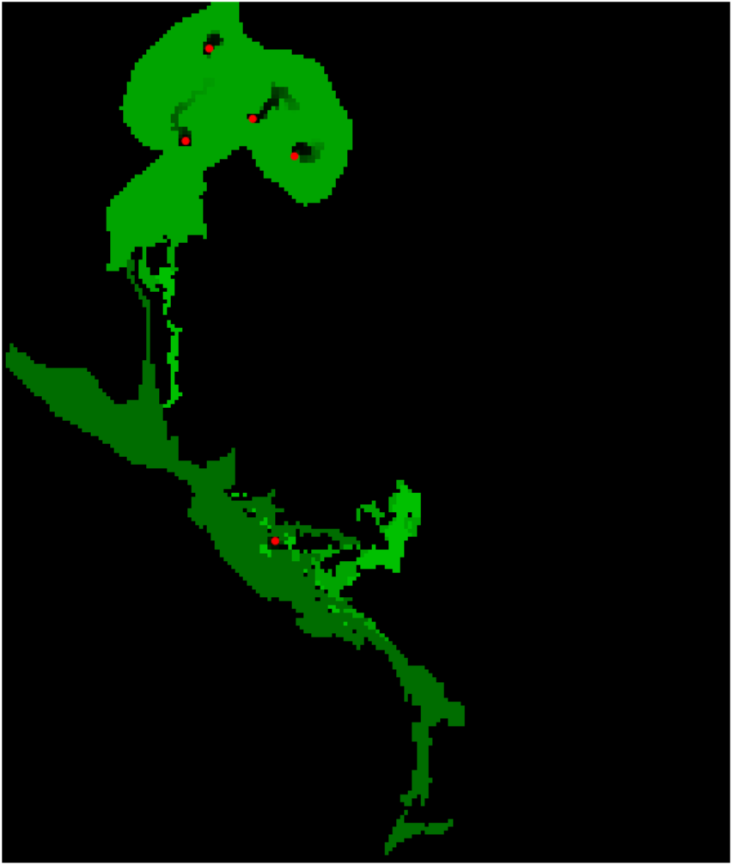


Params:
Regrowth_height=0.002
Move_range=60.0
Params:
Regrowth_height=0.005
Move_range=60.0
Cows
Cows
Shrublands
Shrublands
Grazelands
Grazelands

Slide 2
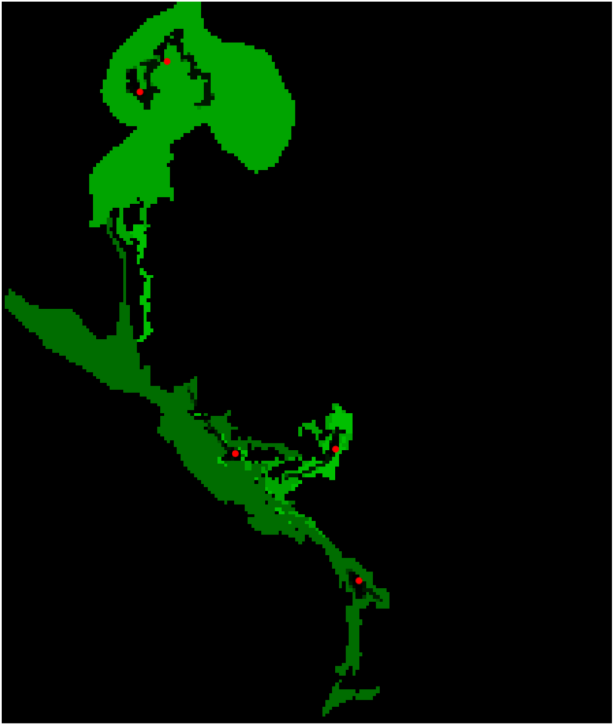
Params:
Regrowth_height=0.0005
Move_range=60.0
Cows
Shrublands
Grazelands

Slide 3
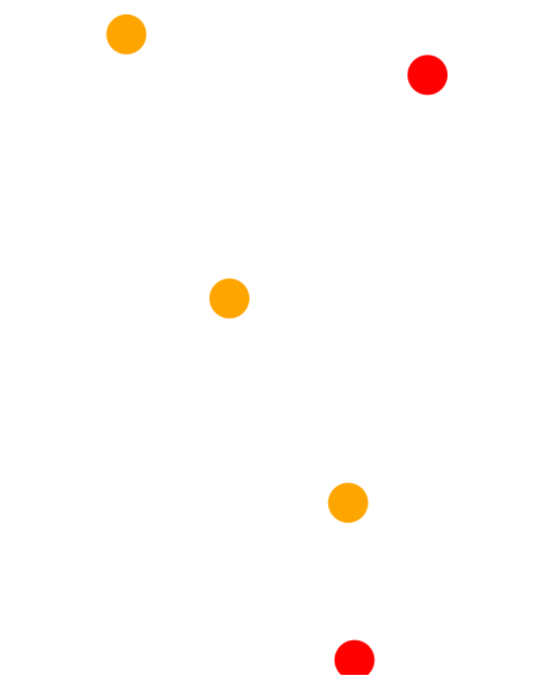
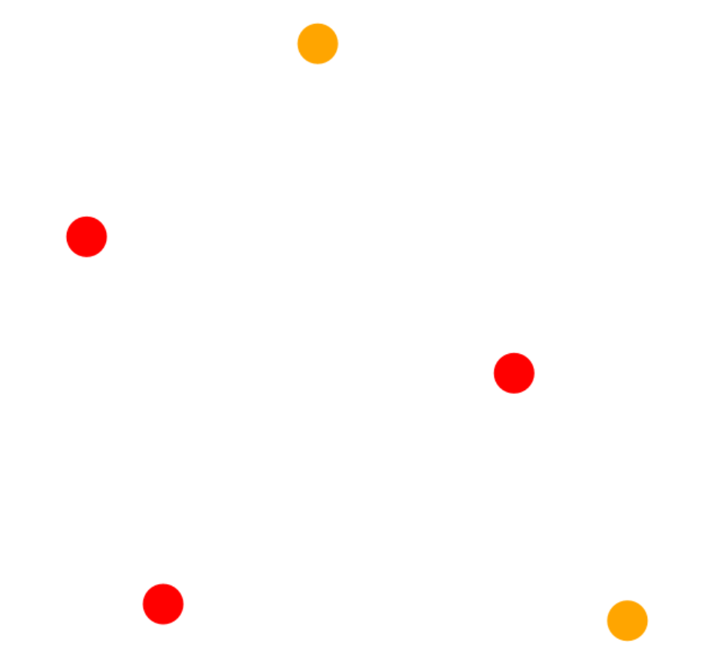
Age<=5
Age>5
Age<=5
Age>5

Slide 4
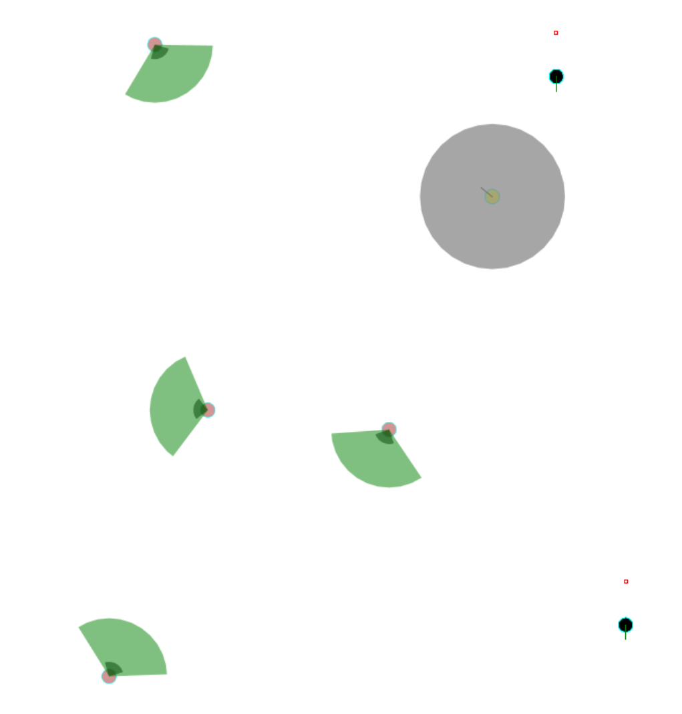
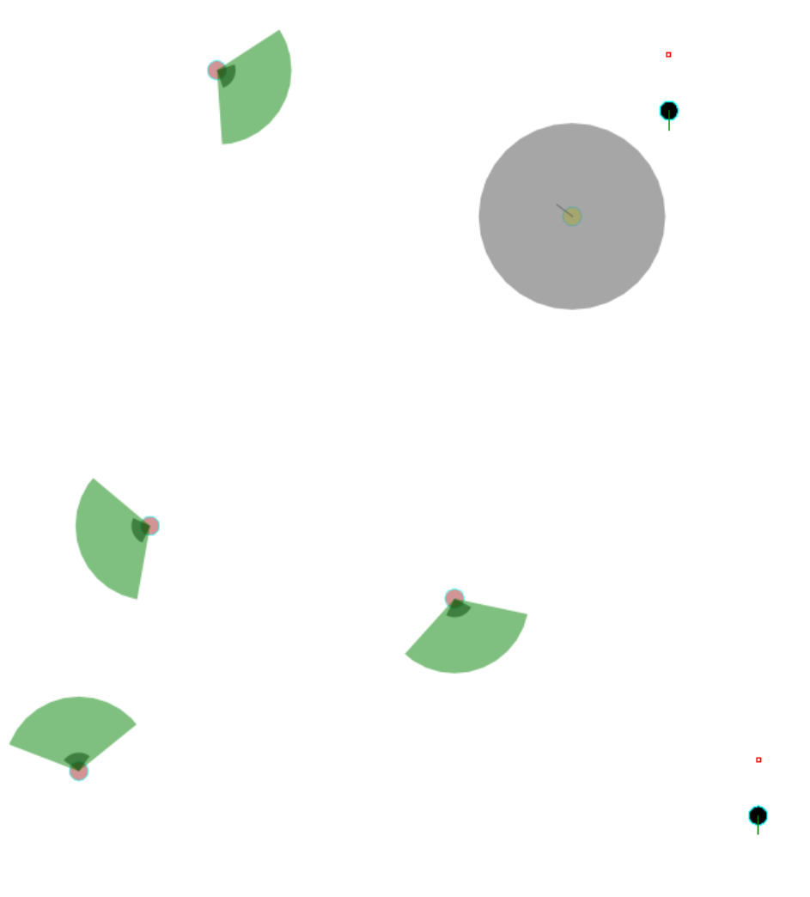
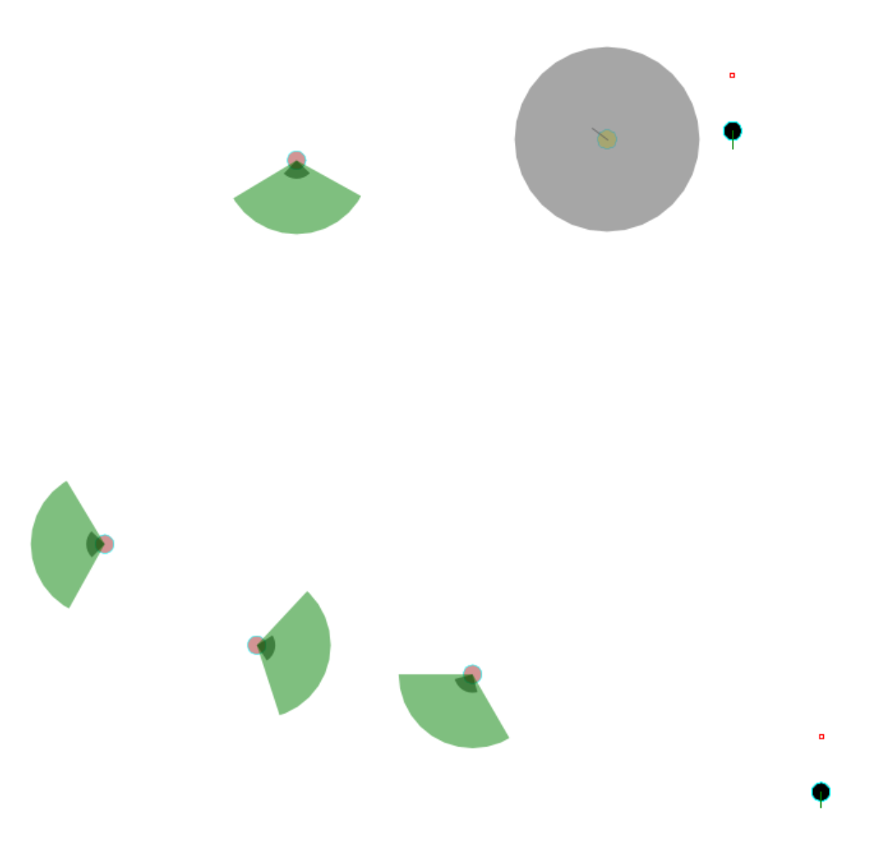
Goats
Bucks’ area
Sheep
Wolves’ position
Cow
Cows’ identify area
Goats
Bucks’ area
Goats
Bucks’ area
Sheep
Wolves’ position
Sheep
Wolves’ position
Cow
Cows’ identify area
Cow
Cows’ identify area

Slide 5
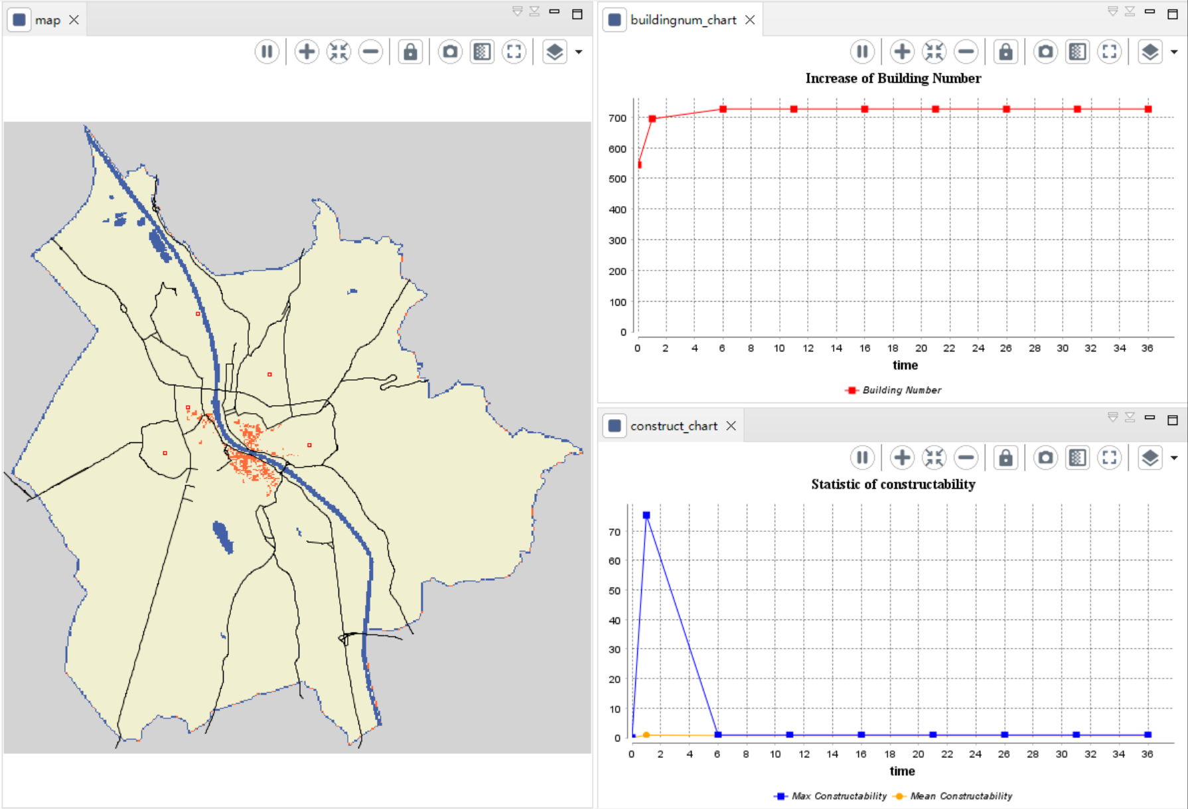
Notes:
normal_situation_90

Slide 6
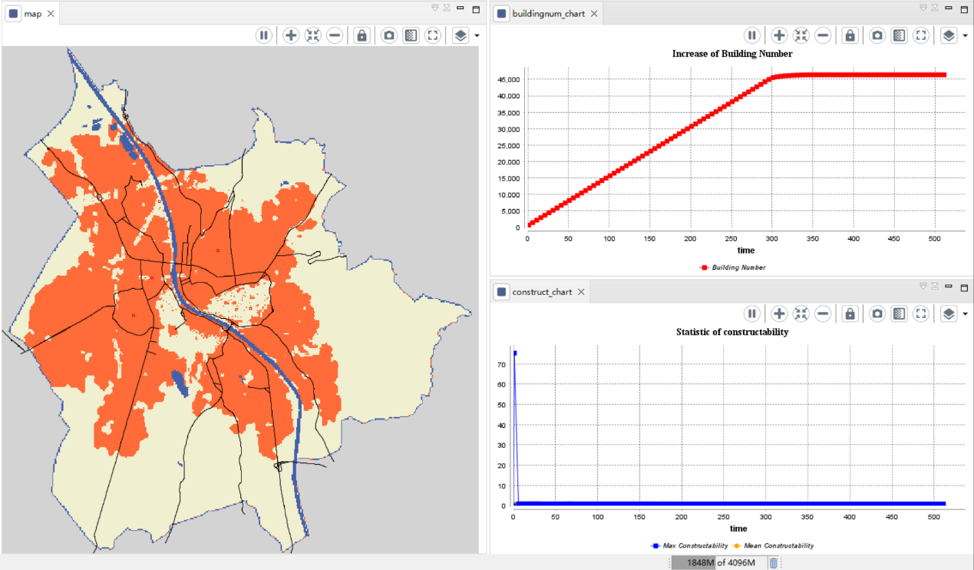
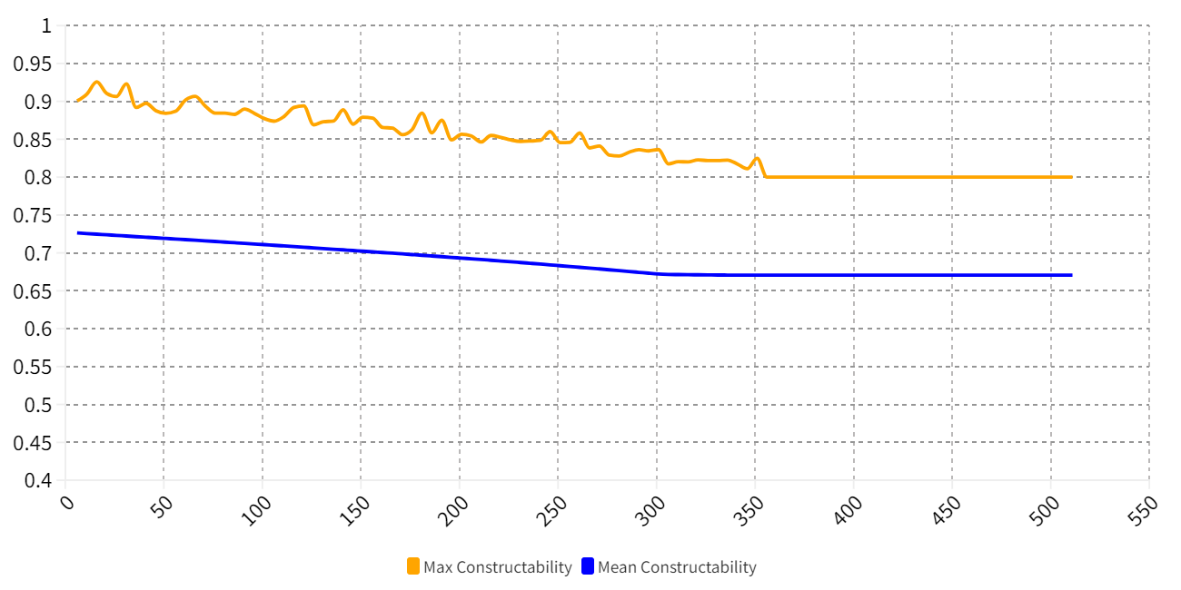
waterbody
city center
built-up area
non-built-up area
Notes:
normal_situation_80

Slide 7
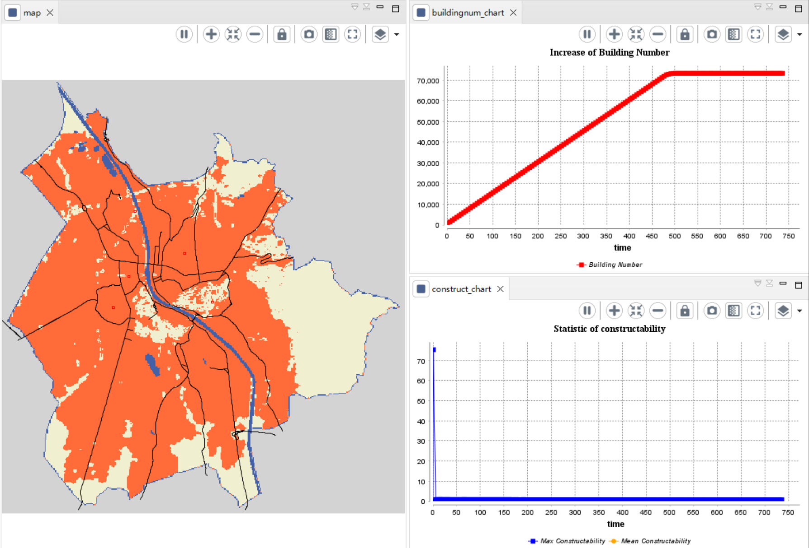
Notes:
normal_situation_75

Slide 8
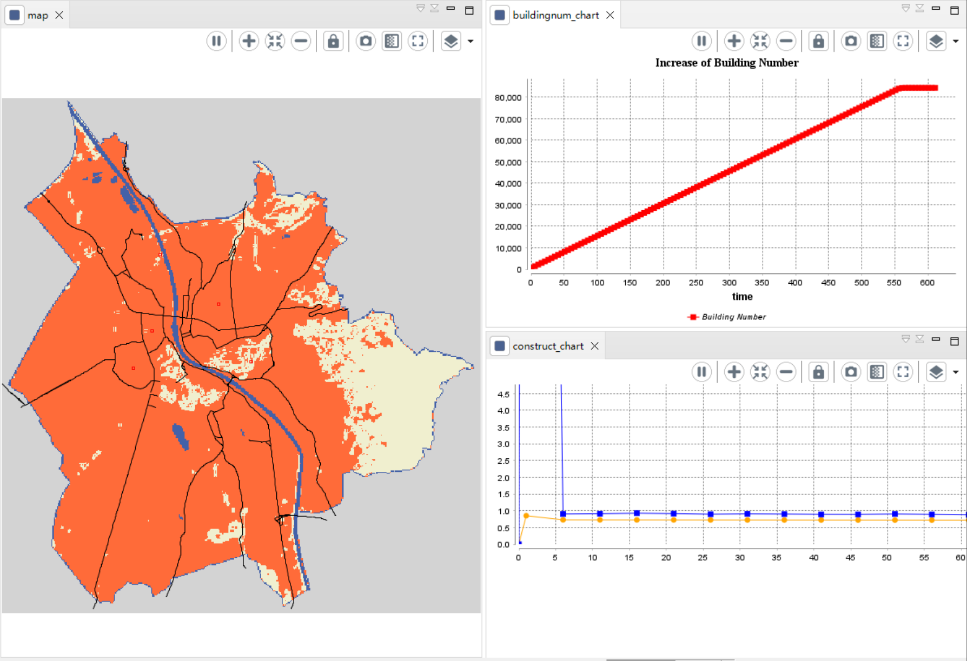
Notes:
normal_situation_70

